Slide 1


The Maritime Provinces Higher Education Commission
Overview of the Commission’s Proposal:
Context and Proposed Institutional Standards
Forum on Quality Assurance:
Towards a Student-centred Approach
March 25, 2013

Slide 2
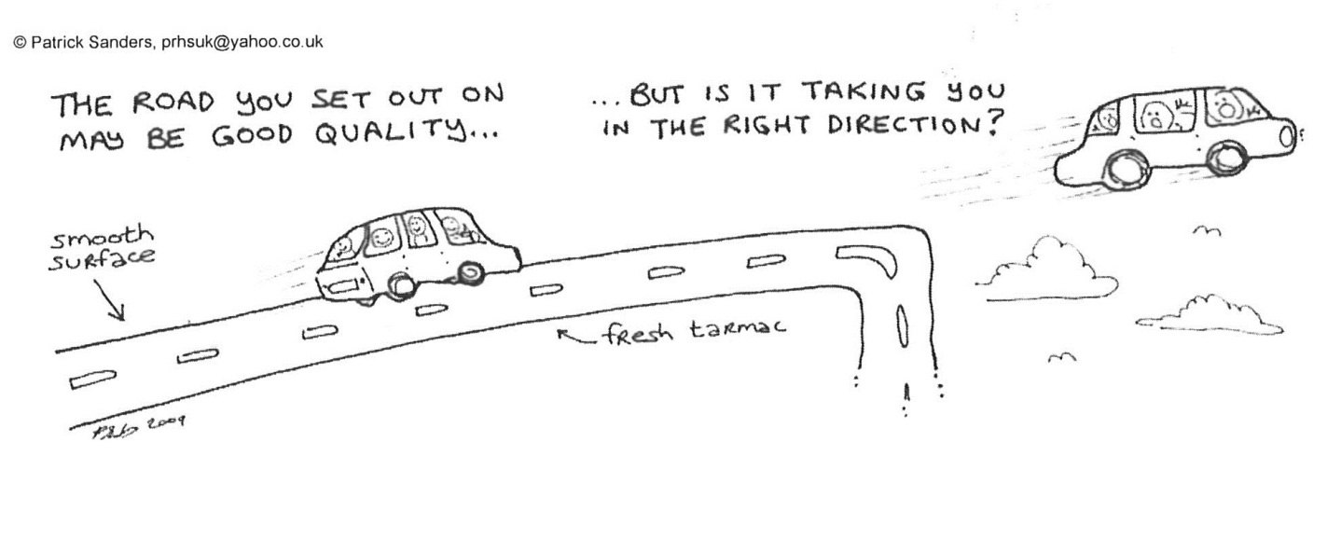
Today’s goal: confirming the direction…

Slide 3




About Us – MPHEC Mandate (2005 Act):
Give first consideration to improving and maintaining the best possible service to students
Take measures to ensure continuous improvement in the quality of academic programs and of teaching
Establish public reporting requirements and produce public reports
Take measures intended to ensure programs are of optimum length and best quality
Take measures intended to ensure teaching quality
Promote smooth transitions between learning and work

Slide 4


The MPHEC
Universities
Commission
Stakeholders
Commission
Staff
Commission
Members
NB
Collaboration
Gov’t & non-gov’t leaders
NS
PEI
Students & public-at-large

Slide 5
Operating Principles
Institutional Autonomy
Public Information Required
Commission Mandate

Slide 6
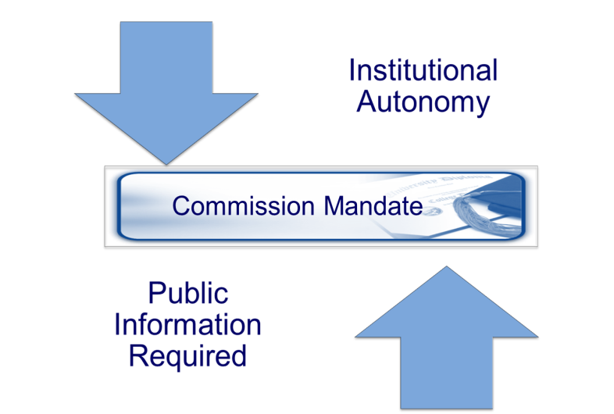
Operating Principles
Best Processes
& Outcomes
emerge from:
Dialogue and
Collaboration

Slide 7
The Commission’sTop Priorities
MPHEC assesses programs
(All programs approved on the condition that the institution review them)
MPHEC validates institutional QA frameworks
Universities assess programs/ services
MPHEC monitors
Student progress through their education --- Graduates’ outcomes

Slide 8
The Commission’s Approach (since 1999)
Modifications/terminations arising are submitted
MPHEC approves (new-modified) programs (prior to implementation) on the condition: Institutional assessment
Universities assess existing programs and services (ongoing)
MPHEC validates institutional QA frameworks

Slide 9
Objective of the Monitoring Process
The MPHEC Aims to…
Provide (public) third-party validation that Maritime universities have suitable QA programs in place to ensure the on-going quality of their activities.
Assist institutions in enhancing (establishing) their QA frameworks.

Slide 10
Monitoring Process: First Cycle
Remarkable progress has been made
Nearly all institutions:
  Have implemented a quality assurance policy
  Were reviewing programs
  Were involving external experts in the assessment process
Important
Gaps Remain
But just as plainly…

Slide 11
Pop Quiz
How likely is it that students are enrolled in an MPHEC-approved degree program?
62% chance 87% chance 99% chance
What proportion of programs have been externally reviewed sometime after MPHEC approval?*
61% 73% 91%

Slide 12
Status of MPHEC-Approved Programs Reviewed by Institutions
Of 386 MPHEC-approved programs
61% had been reviewed
Program Reviews:
Impact of the Monitoring
Process (8 Institutions)

Slide 13


To ensure quality education, how important would you say it is …
To assess the student’s experience?
That program assessments be centered on learning?
To assess curriculum?
To evaluate teaching?
To define and assess student outcomes?

Slide 14
These are the remaining gaps (first cycle)
Assessing the student’s experience
Student/learning-centred self-studies/assessment
Assessing curriculum using established standards
Evaluating teaching
Defining and assessing student outcomes

Slide 15

Second Cycle: Towards Implementation
Revised Standards
Proposed Process for a Second Cycle of Validation
Quality Assurance Discussion Paper
Forum on Quality Assurance
Implementation of revised standards
Validation

Slide 16
Proposed Revised Standards
Then (1999) and Now (2013)
C:\Users\Mireille.MPHEC\Documents\Prezi\guidelines-and-standards-prezi-wxi7s5i10tqt-081_005220_173629

Slide 17
Second Cycle: Towards Implementation
Revised Standards
Proposed Process for a Second Cycle of Validation
Quality Assurance Discussion Paper
Forum on Quality Assurance
Implementation of revised standards
Validation

Slide 18
Proposed MPHEC Monitoring Process (Discussion Paper, p. 13)
Quality Assurance Statement
Campus Site Visit
Draft Report
Action Plan (Institution)
Final Report (MPHEC)
Follow-up on Action Plan Implementation

Slide 19
Second Cycle: Towards Implementation
Revised Standards
Proposed Process for a Second Cycle of Validation
Quality Assurance Discussion Paper
Forum on Quality Assurance
Implementation of revised standards
Validation

Slide 20

Discussion Paper – Students are the Heart:
Quality Assurance at Maritime Universities
Initiated Dialogue on the Challenges at Hand in QA
Received Written Feedback from Stakeholders
Continuing the Dialogue through this Forum

Slide 21
Next Steps Towards Implementation
Revised Standards
Proposed Process for a Second Cycle of Validation
Quality Assurance Discussion Paper
Forum on Quality Assurance
Next steps:
Implementation of Final (revised) standards
Next steps:
Validation of implementation (monitoring)

Slide 22
Today’s goal: confirming the direction…

Slide 23
Group Discussion No.1
Assessment of Academic Programs and Units by the Universities
As a result of responses from the institutions to the first set of Standards (1999 Guidelines), the Commission has further fleshed-out the various elements supporting an institutional QA policy. Considering academic units, how suitable are these standards (sections I-V of the Standards)?
Also as a result of responses from the institutions to the first set of Standards (1999 Guidelines), the Commission has provided additional direction in terms of the assessment standards for the assessment of academic units (section VI of the Standards). Will these assessment standards allow institutions to adequately assess the quality of their academic programs/units? If not, what is missing?
With respect to the revised Standards overall, are there any omissions? Are any corrections or clarifications needed?

Slide 24
Group Discussion No.2
Assessment of Non-Academic Units by the Universities
Now, thinking of non-academic units, to what extent are Sections I-V of the Standards (Purpose of the Standards; Guiding Principles; Scope, Objectives and Components of an Institutional Quality Assurance Policy) suitable for the assessment of non-academic units?
Also in response to feedback received from the institutions, the Commission has developed Assessment Standards for non-academic units (section VI of the Standards), while recognizing that the diversity of these units made the development of a comprehensive list equally suitable to all units challenging. How appropriate are these standards? What is missing?
What are the main benefits and potential pitfalls institutions and the Commission ought to consider in developing the evaluation framework for these units? Should the scope of units be further defined? If so, how? And on what basis?

Slide 25

Thank you
Mireille Duguay, CEO
82 Westmorland Street, Suite 401
Fredericton, NB E3B 5H1
Phone: (506) 453-2844
Fax: (506) 453-2106
MDuguay@mphec.ca

